Slide 1
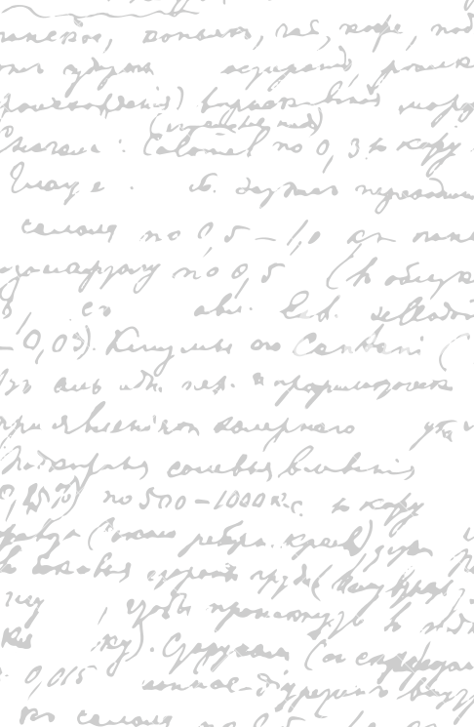



Andrew Wu 2133861w
Yes, Mate!
Project Supervisor Meeting 6
4 December 2020

Slide 2
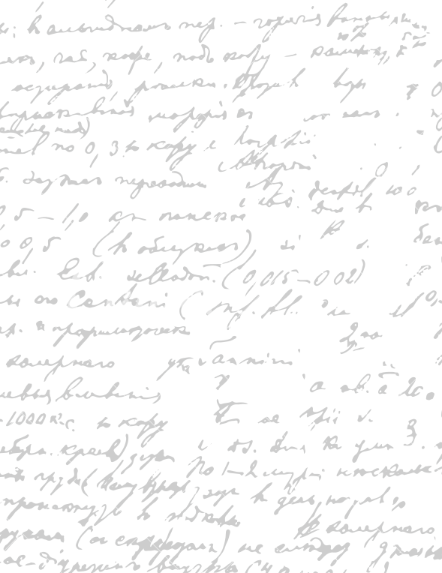



Start Recording

Slide 3
Main Topics
Questions
2. Digital Wireframe
3. Next Week

Slide 4

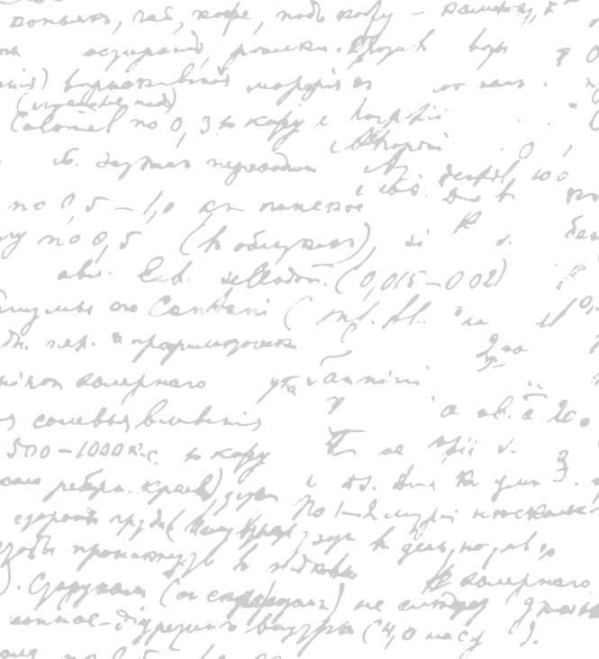

I’m looking to find a great evaluation methods books. What books would you recommend?
What topics should the book cover in our case? Like Cognitive Walkthrough, Interview, Questionnaire and Heuristic Evaluation, think aloud (best)? (time measurement)
What other evaluation methods should I consider?
Questions

Slide 5
Show Digital Wireframe
Use two colour comparison for evaluation
Review food order (user testing)
Think about the colour of the food done, colour blind
Touch screen dirty – waiter presses
Larger screen size so maximum order display
Mobile web
Not app (30%)
Coding platform options
Stress test
Tablet option

Slide 6
Notes for Digital
Wireframe

Slide 7
Continue to Write the Digital Wireframe
Evaluate the Digital Wireframe with Stephen and my Family
Next Week

Slide 8
End

